Slide 1
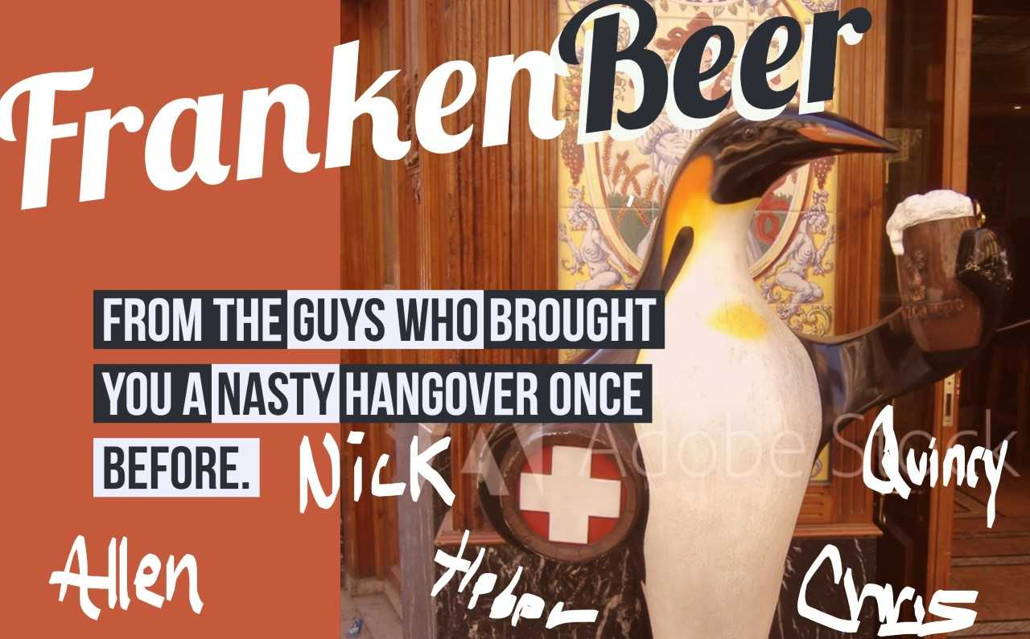

Slide 2
Introduction
The Team
Allen Crane
Nick Cellini
Chris Graves
Heber Nielsen
Quincy Roundtree
The Purpose
Evaluate the microbrewery landscape in the US and recommend expansion markets for our FrankenBeer

Slide 3
Agenda
Introduction
Market Backdrop
Meet FrankenBeer
Where do we go from here?
Initial Market Research
Expansion Market Proposal
Conclusion

Slide 4
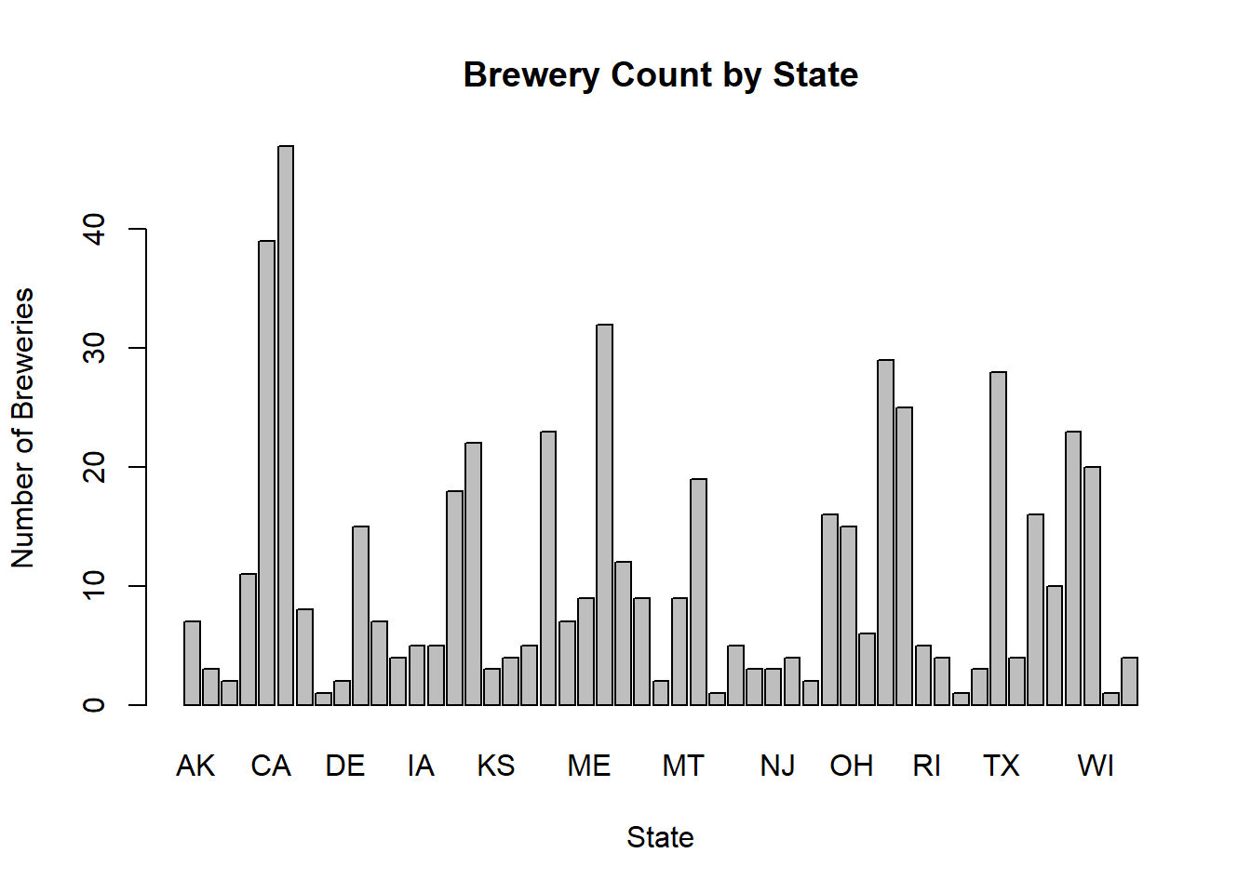
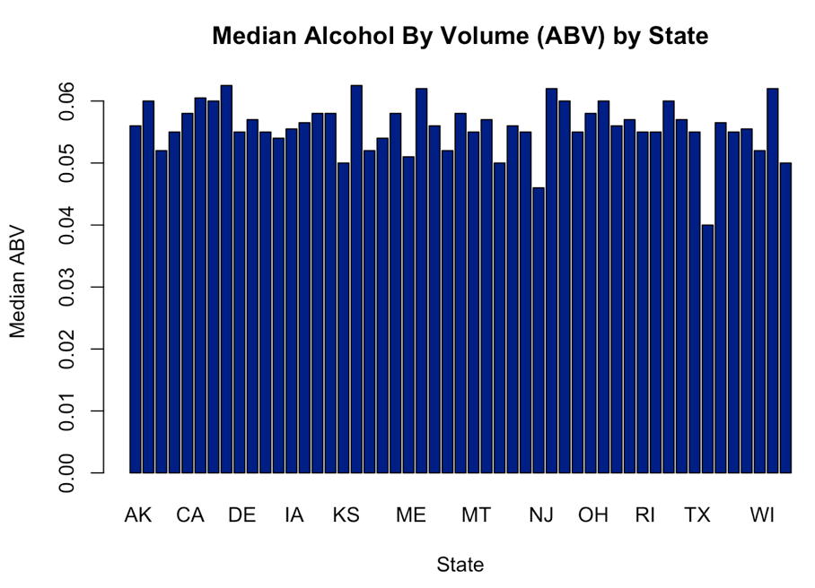
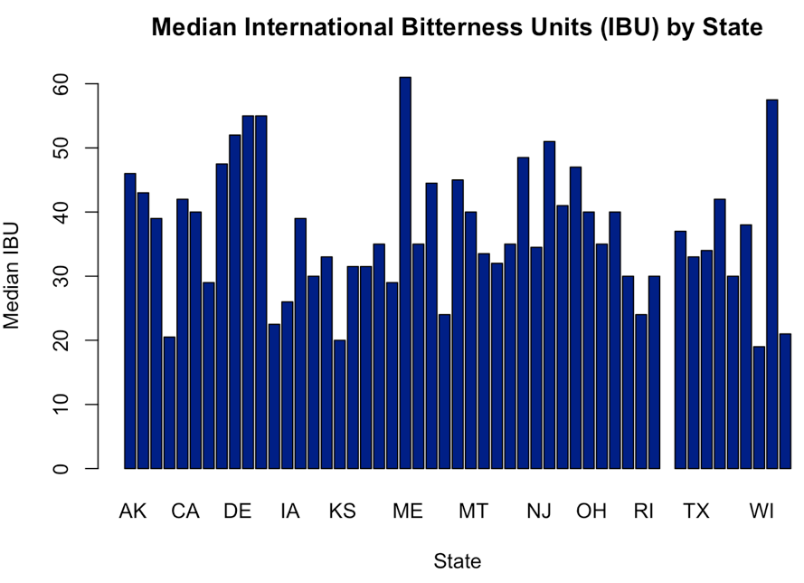
Market Backdrop
The US Microbrew landscape:
Crowded
Expanding
558 US Breweries offering 2,410 beers
The distribution of Breweries:
Highly variable by state
Saturation in Colorado, California, and Michigan
Homes of “old guard” national brands and brews
Median alcohol content (ABV) clustered (~ 5% - 6%)
Median bitterness score (IBU) more variable

Slide 5
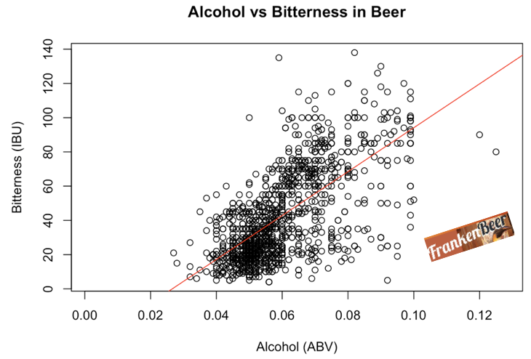
Meet FrankenBeer !
Created to meet demand for:
The crisp taste of high alcohol content
Without the accompanying bitterness.
Novel brewing technique
Delivers 12% ABV
At only 33 IBU’s
Made possible by our new ABRAcadabraTM process (Alcohol Bitterness Reduction & Abatement)
Performed well across multiple levels of ABV
Our dedicated team of full time tasters
AND initial test markets

Slide 6
Where do we go from here?
FrankenBeer
Distinct qualities
Appeals to customers who enjoy strong beers but dislike bitterness
ABRAcadabraTM process:
Provides Franken Brewery a low-bitterness competitive advantage
Extending across all alcohol content levels
Begin FrankenBeer distribution in three new states
Most effectively capitalize on this competitive advantage

Slide 7
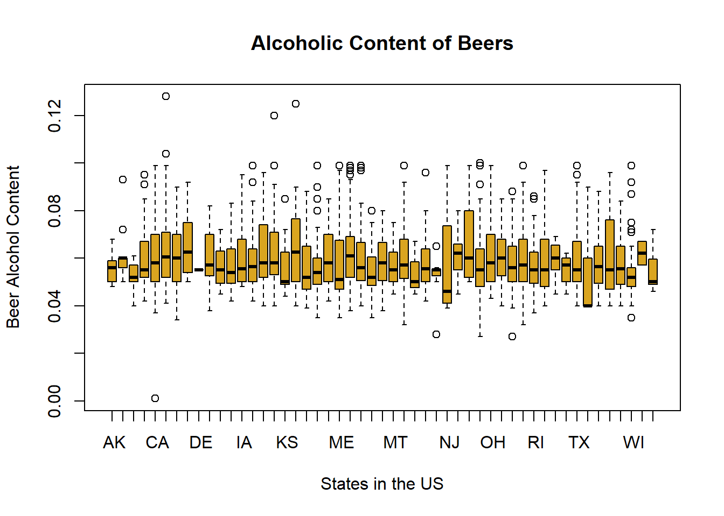
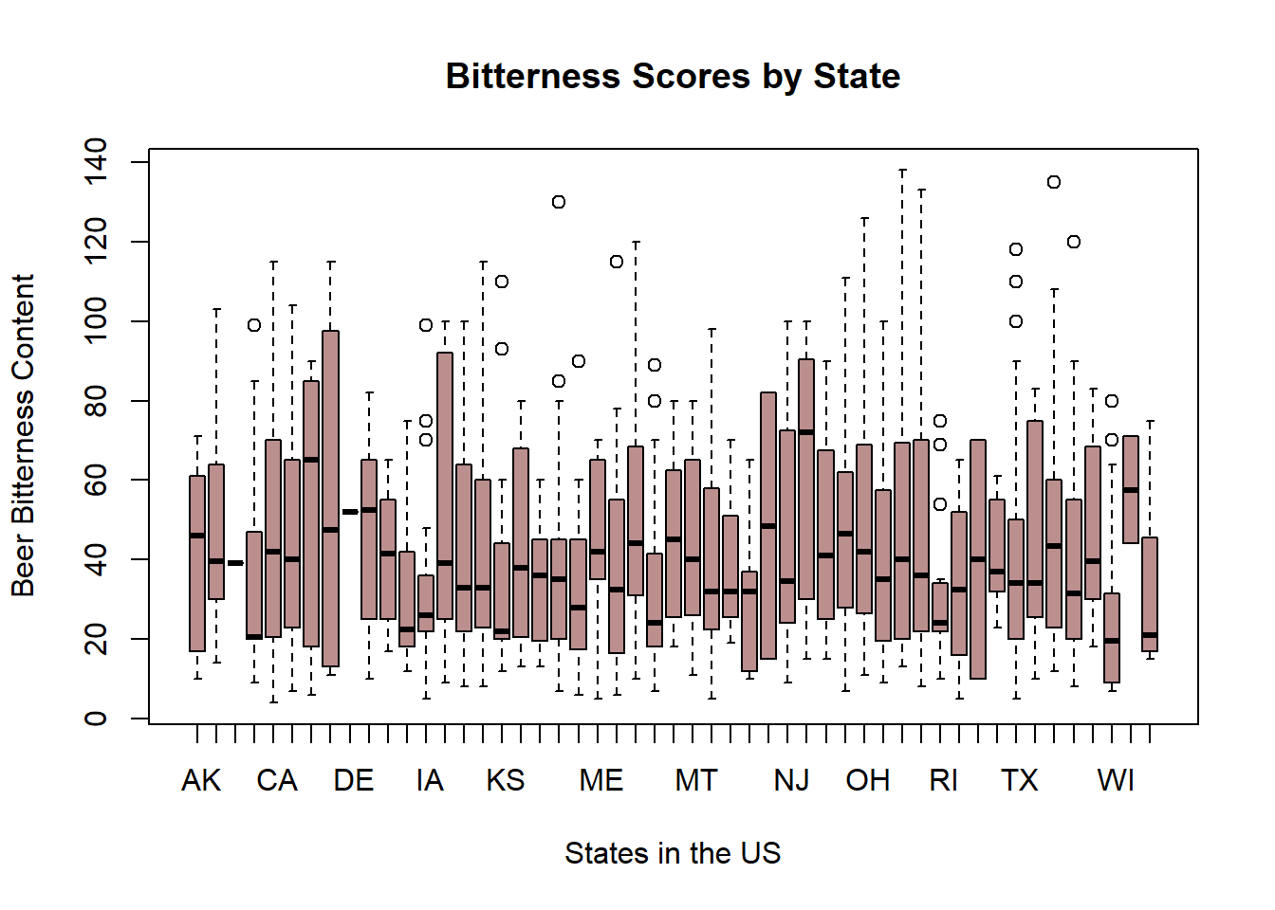
Initial Market Research
First phase:
State-by-state analysis of all US microbreweries
Particular interest - the Alcohol and Bitterness ratings of each variety brewed in each area.
Highest ABV craft beer in the country (ABV 12.8%)
Lee Hill Series Vol. 5 - Belgian Style Quadruple Ale
Brewed in Colorado
The combined management in brewing of alcohol and bitterness
Successfully test marketed in Seattle, Washington and Boulder, Colorado

Slide 8
Expansion Market Proposal
Target market identification:
Our data scientists (in a flash of brilliance) created the FrankenScoreTM
The product of the median ABV by state and the median IBU by state
The FrankenScore metric sizes the advantage of Franken’s new proprietary technique
WV, NM, & FL were identified as having the highest market potential for Frankenbeer
 | Seattle | Boulder | West Virginia | New Mexico | Florida
Median ABV | 6.35% | 5.95% | 6.20% | 6.20% | 5.70%
Median IBU | 75 | 31 | 57.5 | 51 | 55
FrankenScoreTM | 4.7625 | 1.8445 | 3.57 | 3.16 | 3.14
FrankenRankTM (By State) | N/A | N/A | #1 | #2 | #3

Slide 9
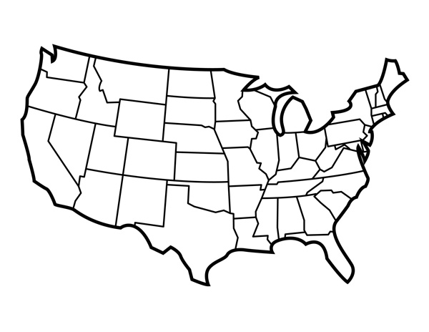
Conclusion
FrankenBeer has distinct qualities
Appealing to beer drinkers in many demographics.
Successful market testing (Seattle, Washington, and Boulder, Colorado)
The FrankenScore (ABV x IBU) ranks West Virginia, New Mexico, and Florida as the top three market states.
FrankenBeer:
High octane ABV of 12%
Subtle IBU of 33
Will make its mark in these new markets.

Slide 10
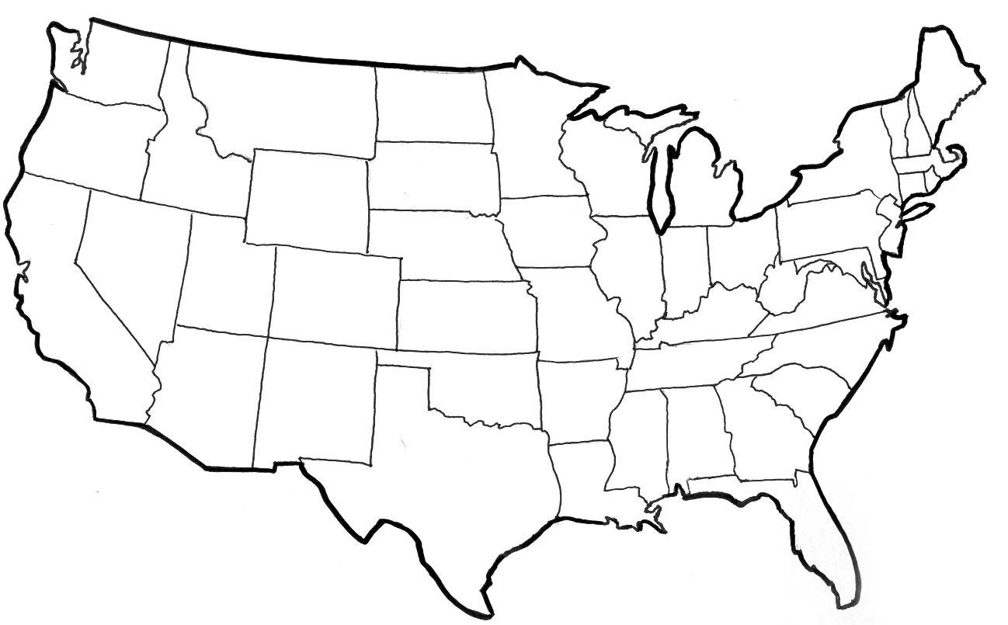
Conclusion
Our FrankenBeer has distinct qualities that make it appealing to many demographics of beer drinkers. Initial testing has been done in the Seattle, Washington and Boulder, Colorado markets with much success.
San Antonio, Texas; Salt Lake City, Utah; and Boston, Massachusetts all have a different craft beer presence, but none like our FrankenBeer.
With its relatively high ABV of 12% and its reltively mild IBU of 33, we believe our FrankenBeer will leave its mark in these new markets.

